Slide 1
Develop effective mail writing skills
CHAPTER 2 : EXPLORE THE IT INDUSTRY

Slide 2

OBJECTIVES FOR THIS SESSION
Understand why emails are important at the workplace
Understand the keys to effective written communication
Differentiate types of email
Understand the different parts of the email

Slide 3



What are the goals of writing an email?
ENGAGE
10 MIN
We are in 2025. You are currently at your workplace.
In which situations would you write an email?

Slide 4


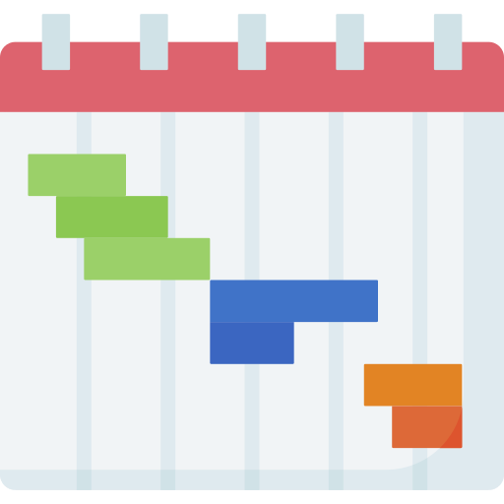



EXPLAIN
The main purposes of an email at work
10 MIN
Provide updates
Plan the tasks and give instructions
Provide documentation and information
Confirm arrangements (meetings, deadlines etc.)
Make requests
Notes:
To provide documentation: Email can be used to provide documentation for important work-related tasks and decisions. For example, you could use email to send a copy of a meeting agenda, minutes, or decision memo.
To give instructions: Email is a good way to give instructions to colleagues or employees. You can use email to provide clear and concise instructions, as well as to track the progress of a task.
To confirm arrangements: Email can be used to confirm arrangements, such as meeting times, travel plans, or delivery dates. This can help to avoid confusion and ensure that everyone is on the same page.
To make requests: Email is a good way to make requests of colleagues or employees. For example, you could use email to ask for a file, a meeting, or help with a project.
To provide updates: Email is a good way to provide updates on work-related projects or tasks. This can help to keep colleagues informed and on the same page.
To resolve issues: Email can be used to resolve issues with colleagues or employees. This can be done by communicating the issue, proposing a solution, and tracking progress.

Slide 5

Email vs Instant messaging
DISCUSS
20 MIN
Instant messaging is getting more and more popular.
Telegram is very often used to communicate work-related topics.
What are the advantages and disadvantages of instant messaging?
TO COMPLETE THIS ACTIVITY :
1
TEAM DISCUSSION
(10 min)
2
CLASS DISCUSSION
(10 min)
Notes:
Trainers: During the 2nd step, if students don’t cover enough key points, you can guide the discussion on specific topics. Example: What if you need to keep track of this conversation?

Slide 6
Email vs Instant messaging
ACTIVITY 1
15 MIN
Would you rather use email or instant messaging? Why?
Notes:
https://wheelofnames.com/tca-p9k

Slide 7
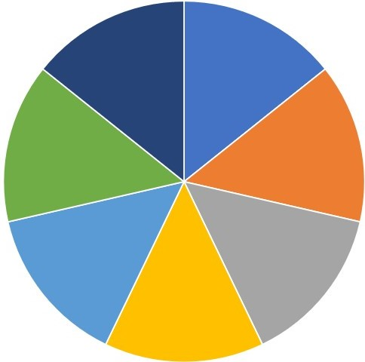
EXPLAIN
7Cs to effective written communication
10 MIN
Completeness
5 Wh questions
Consideration
Consider the reader’s situation
Correctness
Check your grammar, punctuation, spelling
Conciseness
Keep it short
Clarity
Use words and visual aids
Concreteness
Be specific
Courtesy
Be sincere and thoughtful

Slide 8

EXPLAIN
Tips for Clarity
5 MIN
Use short, familiar, conversational words.
Make sure the ideas (tasks) are well-organised
Include examples, illustrations, and other visual aids (as attachments*)

Slide 9

EXPLAIN
Tips for Completeness
5 MIN
Ask yourself wh- questions to see if you have anything else to
add in your email or edit your email:
Example:
Who are you communicating with? (Superiors? Peers?)
What do you want him/ her to do for you?
How are you organizing your ideas? (The flow)
When should you send the email?
Why are you sending this email?

Slide 10
DISCUSS
What have you learned?
10 MIN
Summarize what you have learned during this session!

Slide 11
Homework
HOMEWORK
Read this document for the next session:
https://front.com/blog/writing-email-professionally-words-to-leave-out-of-emails

Slide 12
What’s that?
ENGAGE
5 MIN

Slide 13
What is wrong with those email?
ACTIVITY 2
30 MIN
We are still in 2025 and you are currently at your workplace.
Let’s have at the last seven email you have sent or received.
Something is wrong with each of them. Tell us what!

Slide 14
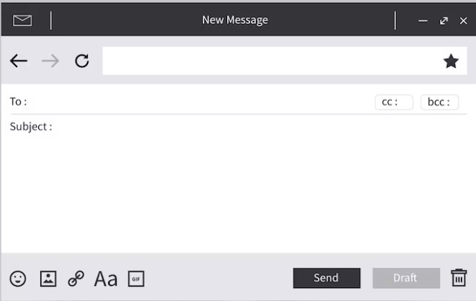
Email 1: You are writing an email to your supervisor to ask for an update.
supervisor@company.kh
Updates on new project
Hey there Bong!
What’s up? Any news about the project?

Slide 15
Email 2: You are writing an email to a colleague on a product update.
colleague@company.kh
Product update
Hello Sokheng,
I sent out the document this morning at 11 pm. Please check the receipt. If you have questions, let me know.

Slide 16
Email 3: You are writing an email to a client asking for their preferences.
Client-isabelle@client.kh
Ask client’s preference
Dear Ms Isabelle,
We are very honoured that you’ve chosen us to support you in hosting the event. I was wondering what colour you would like for the background of the photo booth. I’m not sure what colours there are yet, but I think my supervisor will know…

Slide 17
Email 4: You are writing an email to a partner who will hold an event in two weeks.
External-partner1@partner.kh
Event planning
So, I was wondering if you have decided on the venue or place for our event which will be in two weeks, like 14 days? As I have to send out invitations to our guests.

Slide 18
Email 5: You are writing an email to your colleague who resumed work after a surgery.
Colleague@company.kh
Welcome back
Dear Monyroth,
Welcome back. I see that you have a full day of meeting, but there is a lot of things that you haven’t done. I tried to cover your tasks when you were away, but there’s too many. Let’s meet at lunch to talk more about it?

Slide 19
Email 6: You’re writing an email to your supervisor explaining your ideas on a project that you’re working on.
supervisor@company.kh
Project
Dear Mr Chan,
I am writing to explain to you the details on the project with SONIA Hotel. They wanted to make their webpage more user-friendly, like one of the templates, I think it was the black and blue one with stripes during our meeting last Tuesday.

Slide 20
Email 7: Your colleague read your email and responded to you as follows:
supervisor@company.kh
Project
Hello Makara,
I’m not sure if I understand you correctly. In the 1st paragraph, you were saying that the client preferred Design 1: black and blue in the beginning, but then their manager preferred Design 2: purple and blue in the last paragraph. Do we go with the first or second design?

Slide 21



The different types of emails
EXPLAIN
10 MIN
Inquiry email
Informational email
Sales & marketing email
Ask for information
Arrange a meeting
Follow-up on a project
You expect a reply
Provide information
Share details on a project or event
No reply is expected unless stated
Promote a product
Sell a product or a service

Slide 22
The different parts of the email
EXPLORE
5 MIN
Test your knowledge with this game!

Slide 23
The different types of recipients
EXPLORE
5 MIN
Test your knowledge with this game!

Slide 24
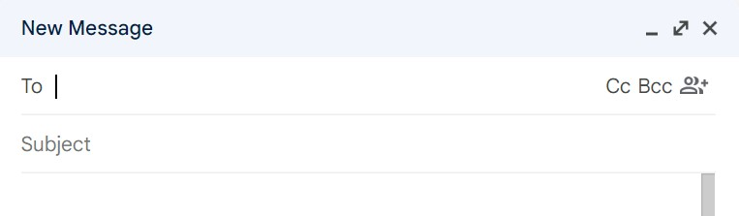
The different types of recipients
EXPLAIN
10 MIN
CC situation: My supervisor requires me to work late on Friday. When he informs me of this decision, he also cc-s his secretary to inform her that I’ll be working late. She is not required to work late like me on Friday.
BCC situation: You are sending this email to several clients but don’t want them to know that they are not the only recipient.

Slide 25
EXPLAIN
Write the subject line
10 MIN
What is wrong with those subject lines:
Hi!
Click here!
Urgent!
I am writing this email to inform you…

Slide 26


Tips for a powerful subject line
EXPLAIN
Be precise and clear with the purpose
What do you want?
Include keywords
so people can search for it afterwards

Slide 27


EXPLAIN
Tips for salutations
To people of professional relationships:
Dear Mr/ Mrs/ Ms +Surname,
To people you don’t know:
Dear Sir/Madam,
To people you know well:
Dear + name they go by,
​សូមគោរព+ឈ្មោះ
សូមគោរពលោក/លោកស្រី/កញ្ញា+នាមត្រកូល
សូមគោរពលោក/លោកស្រី
Don’t forget the “,” afterwards

Slide 28
What to avoid when writing an email
DISCUSS
10 MIN
What do you remember from the homework?
Share your notes with your neighbor.

Slide 29

EXPLAIN
Tips for the body of your email
10 MIN
One topic = one paragraph
Have a clear objective
Language issues to be aware of…
Formality (Formal: Could you please have a look at the file?
VS. Informal: Take a look at the file)
Cut out general wordiness
Avoid jargon/ slang
Notes:
End of session

Slide 30

ENGAGE
Let’s review what we have learned
15 MIN

Slide 31
ACTIVITY 3
Improve those emails!
60 MIN
We are still in 2025 and you are currently at your workplace.
You are the recipient of those emails. You underline those parts. Do they show effective or poor email writing skills? Why?
TO COMPLETE THIS ACTIVITY :
1
TEAM WORK
(40 min)
2
CORRECTION
(20 min)

Slide 32
HOMEWORK
Homework
Look at this video and take notes

